Slide 1
WEB PROJECT
PROPOSAL
Here is where your presentation begins

Slide 2
TABLE OF CONTENTS
01
04
About the Project
Sneak Peek
02
05
Major Requirements
Project Stages
03
06
Project Goals
Our Team
Here you could describe
the topic of the section
Here you could describe
the topic of the section
Here you could describe
the topic of the section
Here you could describe
the topic of the section
Here you could describe
the topic of the section
Here you could describe
the topic of the section

Slide 3
OUR COMPANY
GOSTUDIO
Mercury is the closest planet to the Sun and the smallest one in the Solar System—it’s only a bit larger than our Moon. The planet’s name has nothing to do with the liquid metal since it was
named after the Roman messenger god, Mercury.

Slide 4
WHAT WE ARE WORKING ON
SECURE
ACCESSIBLE
FAST AND RELIABLE
Mercury is the closest planet to the Sun
Despite being red, Mars is a cold place, not hot
Neptune is the farthest planet from the Sun

Slide 5
ABOUT THE PROJECT
Mercury is the closest planet to the Sun and the smallest one in the Solar System—it’s only a bit larger than our Moon. The planet’s name has nothing to do with the liquid metal since it was named after the Roman messenger god, Mercury

Slide 6
—SOMEONE FAMOUS
“This is a quote. Words full of wisdom that someone important said and can make the reader get inspired.”

Slide 7
NOW
POOR DESIGN
PROGRAMMING MISTAKES
LACK OF ADAPTABILITY

Slide 8
FUTURE
BRANDING
POSITIONING
ADAPTABILITY

Slide 9
MAJOR REQUIREMENTS
IMAGES
USER EXPERIENCE
INFORMATION
Despite being red, Mars is a cold place, not hot. It’s full of iron oxide dust
Venus has a beautiful name and is the second planet from the Sun
Mercury is the closest planet to the Sun and the smallest in our Solar System

Slide 10
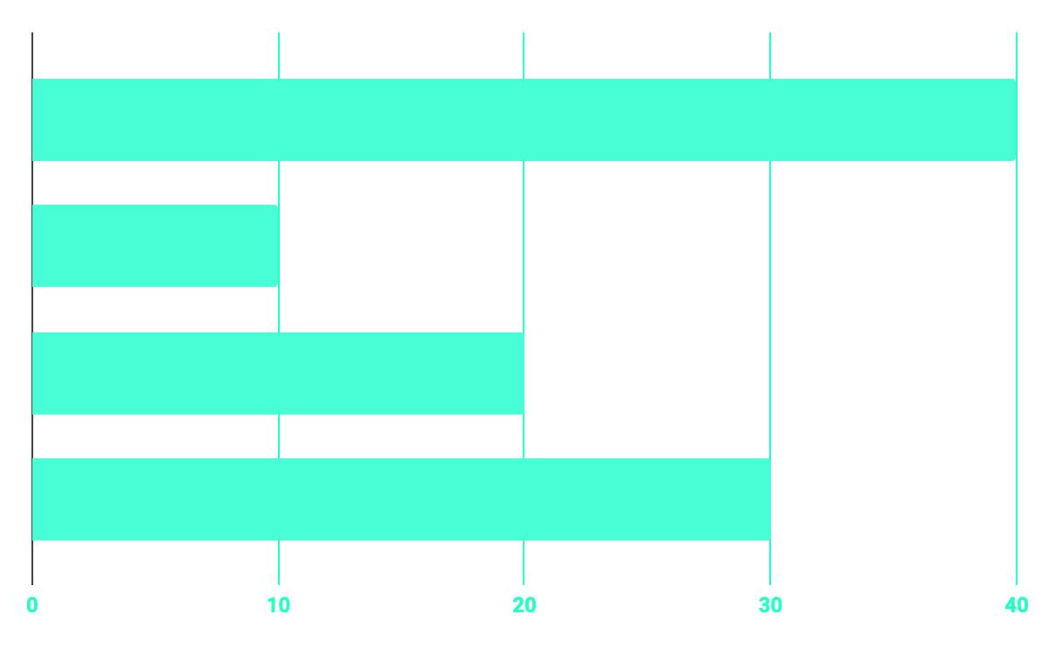
BUDGET
40%
20%
PROGRAMMING
10%
30%
DATABASE
WEB DESIGN
UX RESEARCH

Slide 11
OUR GOALS
EXPANSION
POSITIONING
USABILITY
Neptune is the fourth-largest planet in our Solar System
Venus has a beautiful name and is the second planet from the Sun
Despite being red, Mars is a cold place, not hot. It’s full of iron oxide dust

Slide 12
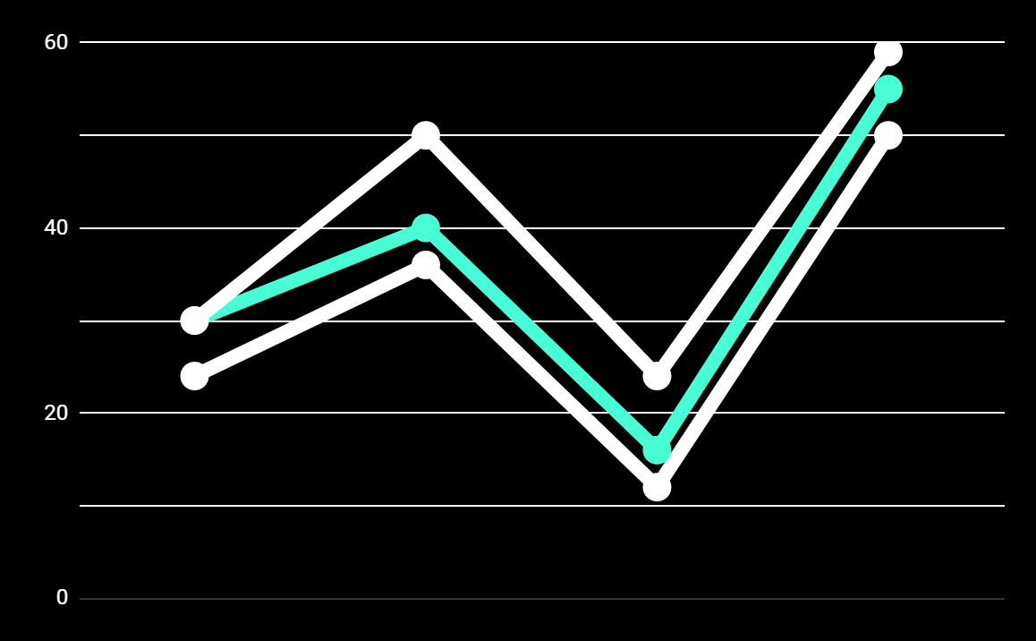
PREDICTED RESULTS
CONVERSIONS NEXT YEAR
+20%
MONTHLY VISITS
+33%
CONVERSION RATE
+40%
ANNUAL ORDERS

Slide 13
SNEAK PEEK
HEADER
TEXT
SLIDER
ICONS

Slide 14
A VIDEO IS A GOOD IDEA
Insert your multimedia content here

Slide 15
PROJECT STAGES
STEP 2
STEP 1
STEP 3
Venus has a beautiful name and is the second planet from the Sun
Despite being red, Mars is a cold place, not hot. It’s full of iron oxide dust
Saturn is a gas giant, composed mostly of hydrogen and helium

Slide 16
OUR TIMELINE
WEEK 1
WEEK 3
BETA
RELEASE
FINAL
VERSION
WEEK 2
WEEK 4
Improvements
Increased traffic
Focus group
Progress review

Slide 17
OUR PARTNERS
MARS
VENUS
MERCURY
Mercury is the closest planet to the Sun and the smallest one in our Solar System
Despite being red, Mars is a cold place, not hot. It’s full of iron oxide dust
Venus has a beautiful name and is the second planet from the Sun

Slide 18



THE TEAM
JENNA DOE
JOHN DOE
JIMMY DOE
You can replace the image on the screen with your own
You can replace the image on the screen with your own
You can replace the image on the screen with your own

Slide 19
THANKS!
Does anyone have any question?
addyouremail@freepik.com
+91 620 421 838
yourcompany.com

